Slide 1
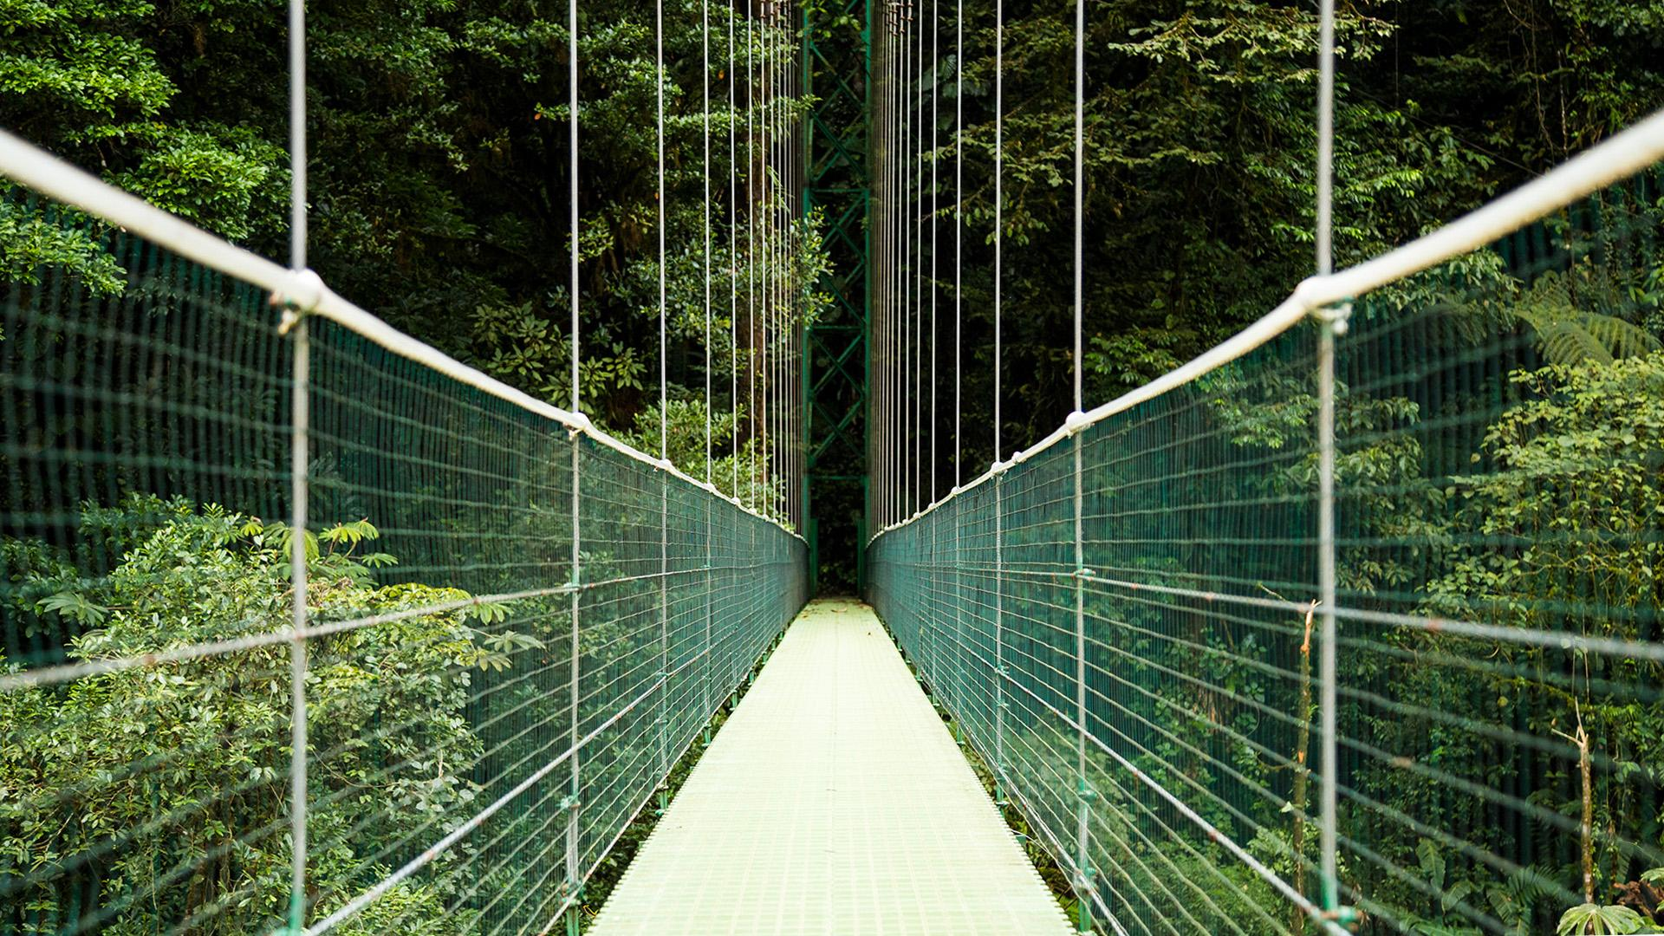
GEO
HUNT
G4 Team H
Stephen Pang Khoo Chee Kuang Gary Lim Lim Yin Shan Isaac Einstein Fong
Tan Hua Juan

Slide 2
TABLE OF CONTENT
01
02
03
04
OVERVIEW
USER SCENARIOS
BEYOND THE LAB
CONCLUSION

Slide 3
OVERVIEW

Slide 4
PROBLEM STATEMENT
Lesser people are travelling out since the COVID-19 Circuit Breaker period
According to MedicalNewToday, approximately 32% of the participants had overweight,
34% had obesity. The results of the online survey demonstrated substantial lifestyle changes during the pandemic.
Notes:
To encourage

Slide 5
Solution
GEOHUNT
A treasure hunting game
Notes:
To encourage user to move around and to explore Singapore by playing this treasure hunting game.
Of cos, there are also attractive price to be won and redeem, just like usual treasure hunt you seen in the movie..

Slide 6
USER SCENARIOS

Slide 7
USER SCENARIOS
OPEN BOX
CREATE BOX
PURCHASE MEMBERSHIP
PURCHASE IN-GAME ITEM
VIEW LEADERBOARD

Slide 8
3 MAIN USER SCENARIOS
PURCHASE
IN-GAME ITEMS
CREATE BOX
OPEN BOX
User plants a GeoTreasure box at their current location
User goes to a location with a GeoTreasure box
User opens the GeoTreasure box
User purchases in-game items from virtual store
Notes:
Now i will pass on to yin shan to explain more on the create box scenario.

Slide 9

USER CREATES BOX
Legend
Micro-service
External service
Scenario Overview Diagram
Creating a Box on Box Hunt
2. Create a Box
{username}
Application UI
Creating a GeoTreasure Box
GeoHunt Enterprise Solution
HTTP POST
HTTP POST
4. Return box creation success or error
3. Return box creation success or error
Customer
Black box!!!
Notes:
So over here is the SCENARIO OVERVIEW DIAGRAM for user creating a treasure box, where the blackbox would be explained later in further details. Now cheekuang will show you our app demo, from the user’s perspective. (Move to the website to showcase your user DEMO while freeze this screen) and say this --> The user has 3 chances to do so daily, and it resets at 12am.

Slide 10
USER CREATES BOX
Legend
User
Microservice
Micro-service
User Scenario Diagram
External service
3. Return boxes that user has left
{daily_boxes}
2. Get number of boxes users has left
Geolocation
Microservice
HTTP GET
5. Create user’s current location coordinates
HTTP POST
Google Maps Geolocation API
4. Get user’s current location
11. Return update success or error
10. Update boxes that user has left
{daily_boxes}
HTTP GET
7. Return user’s current location
{lat, lng}
6. Return user’s current location coordinates
{lat, lng}
HTTP PUT
Create_Box
Microservice
12. Error/Activity Message
sent to RabbitMQ
RabbitMQ
Activity Log
Microservice
1. Create a Box
{username}
13. Return
box creation
success or error
8. Send a Box Creation Request
{username, latitude, longitude}
HTTP POST
HTTP POST
9. Return Success or Error
Application UI
Creating a GeoTreasure Box
Box Microservice
Error Log
Microservice
Notes:
Remember the blackbox from the scenario overview diagram on your left? Now let me show you a detailed, user scenario diagram for user creating a box on the right.
Assuming the user has already logged in, so when the user interacts with the UI to plant the box, the UI will send a request to the Create_box microservicem, which is an orchestrator,
The orchestrator then gets from the User microservice, the number of daily boxes the user has left to plant.
The user microservice then returns the chances back to the Create_box,
and if there are enough, the create_box would continue on to get the user’s current location from the geolocation microservice,
which gets the coordinates via the google maps geolocation api, which we need, to get the user’s current location.
Then, the API returns the users current location’s coordinates, including the latitude and longitude back to the geolocation microservice and
it returns back to the create_box microservice’s the user’s current location.
Then, the create_box microservice sends a box creation request to the box microservice with details such as the location retrieved before and the username,
to which the box microservice would return whether the box creation was a success or failure (error) to the create_box microservice.
If it is a success, the create_box microservice would send a request to the user microservice to update the number of box planting chances the user has left for that day,
and the user microservice would then return whether the update was successful.
Lastly, all of the requests and returns made by the create_box microservice would be sent to RabbitMQ, to log the errors or successes during box creation activity, to the respective microservice: which are the activity log or error log, depending on the routing key each message has.
Why we use RabbitMQ? This is so that in the event where there are alot of concurrent users using app, and if everything gets logged at one shot, it may lead to overload of services and ultimately app failure. So to prevent logging everything at one shot, we use RabbitMQ to queue the message instead to ensure the app is running smoothly.
Lastly, if the message is sent to RabbitMQ successfully, then the create_box microservice would return the box creation’s status - whether it was a success or failure to the UI, for the users to see.

Slide 11
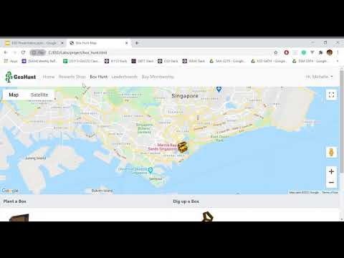
CREATE BOX
Notes:
Now, we will take you through this scenario.

Slide 12
OPEN BOX
Legend
Micro-service
External service
Scenario Overview Diagram
Search for nearby box
2. Get nearby box details
Application UI
Find & Open GeoTreasure box
GeoHunt Enterprise Solution
HTTP GET
HTTP GET
4. Return nearest box details or error
3. Return nearest box details or error
Customer
Black box!!!
Notes:
So over here is the SCENARIO OVERVIEW DIAGRAM for user creating a treasure box, where the blackbox would be explained later in further details. Now cheekuang will show you our app demo, from the user’s perspective. (Move to the website to showcase your user DEMO while freeze this screen) and say this --> The user has 3 chances to do so daily, and it resets at 12am.

Slide 13
OPEN BOX
Legend
Micro-service
User Scenario Diagram
Google Map API
External service
3. Create user’s current location coordinates
Geolocation Microservice
HTTP POST
4. Return user’s current location
{current_longitude,current_latitude}
2. Get user’s current location
5. Return user’s current location
{current_longitude,current_latitude}
HTTP GET
Application UI
Find & Open GeoTreasure box
1. Get nearby virtual
box details
6. Check if location correlates to any created box’s location
Box
Microservice
Box Opening Microservice
HTTP GET
HTTP GET
11. Return nearest box details or error
7. Return nearest box_details or Error
{box_id,box_contents, points}
HTTP PUT
Error Log
Microservice
9. Return user update
success or error.
10. Log successful box
opening or error
8. Update user’s points and inventory
{box_contents, total_points}
User Microservice
RabbitMQ
Activity Log
Microservice
Notes:
Remember the blackbox from the scenario overview diagram on your left? Now let me show you a detailed, user scenario diagram for user opening box, on the right.

Slide 14
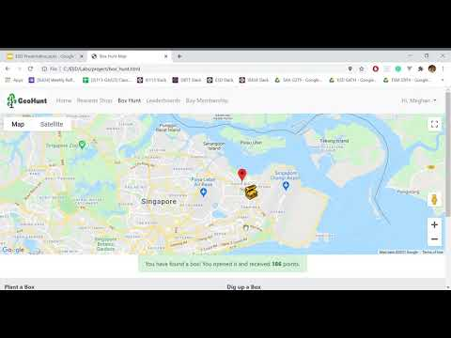
OPEN BOX

Slide 15
PURCHASE IN-GAME ITEMS
Legend
Micro-service
External service
Scenario Overview Diagram
Send Order Information {cart_data}
2. Send Order Information {username, cart_data}
Application UI
Placing an order for incentives
GeoHunt Enterprise Solution
HTTP POST
HTTP POST
4. Return successful purchase or error
3. Return successful purchase or error
Customer
Black box!!!
Notes:
So over here is the SCENARIO OVERVIEW DIAGRAM for user creating a treasure box, where the blackbox would be explained later in further details. Now cheekuang will show you our app demo, from the user’s perspective. (Move to the website to showcase your user DEMO while freeze this screen) and say this --> The user has 3 chances to do so daily, and it resets at 12am.

Slide 16
PURCHASE IN-GAME ITEMS
Legend
Micro-service
User Scenario Diagram
External service
User Microservice
4. Update balance and inventory if user has enough points to purchase.
{cart_data: [ {item, price, quantity} ...] }
HTTP PUT
5. Return successful purchase or error
Error Log
Microservice
Order
Microservice
6. Log successful purchase to activity log or error to error log
RabbitMQ
1. Send Order Information
{username, cart_data}
HTTP POST
Activity Log
Microservice
7. Return successful purchase or error
2. Create Order Request
{cart_data: [ {item,quantity} … ] }
HTTP POST
3. Return Order Request
{cart_data: [ {item, price, quantity} ...] }
In-Game shop
Microservice
Application UI
Placing an order for incentives
Notes:
Remember the blackbox from the scenario overview diagram on your left? Now let me show you a detailed, user scenario diagram for user purchasing in-game items, on the right.
First, the user will place an order through the application
Next order information will be sent to the order microservice via a HTTP POST request
Order microservice will create an order request and send it to the ingame shop microservice via HTTP POST
The ingame shop microservice will then return the order request
The order microservice will send a HTTP PUT request to the user microservice to update the user’s account balance and inventory if the user has enough points to purchase
This will return either a successful purchase or an error
The successful purchase or the error log will be sent to rabbitMQ and will respectively be sent to the error log microservice or the activity log microservice
The order microservice will then return a successful purchase or an error to the application UI

Slide 17
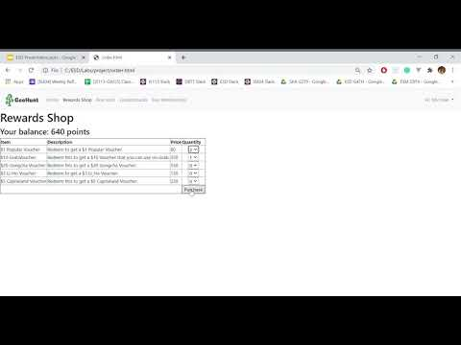
PURCHASE IN-GAME ITEMS

Slide 18
BEYOND THE LAB

Slide 19
BEYOND THE LAB
PAYPAL API
GOOGLE MAP API
ERROR HANDLING

Slide 20


Slide 21
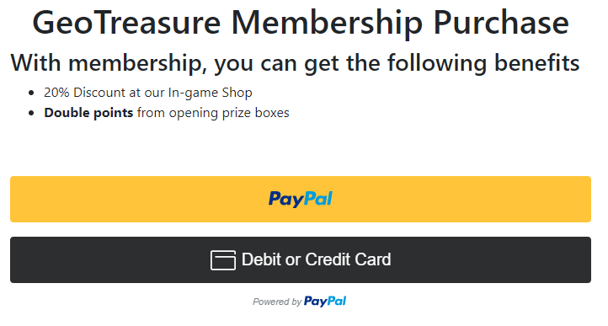
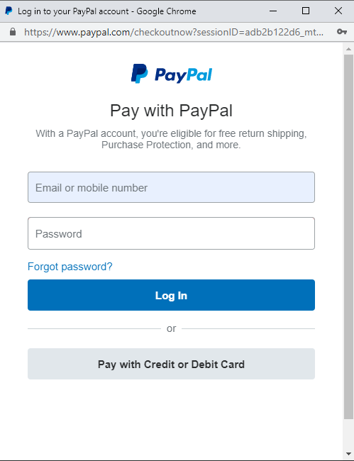

Slide 22


Slide 23
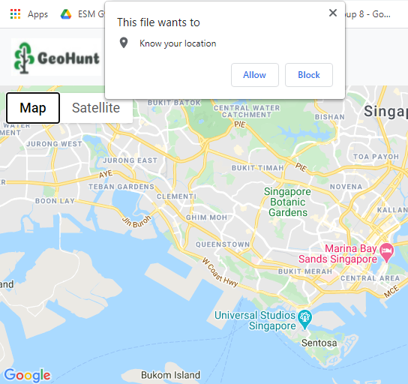
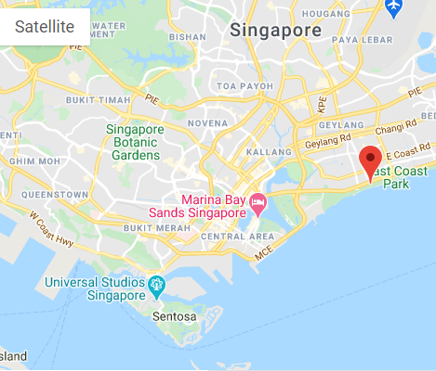

Slide 24
ERROR HANDLING

Slide 25
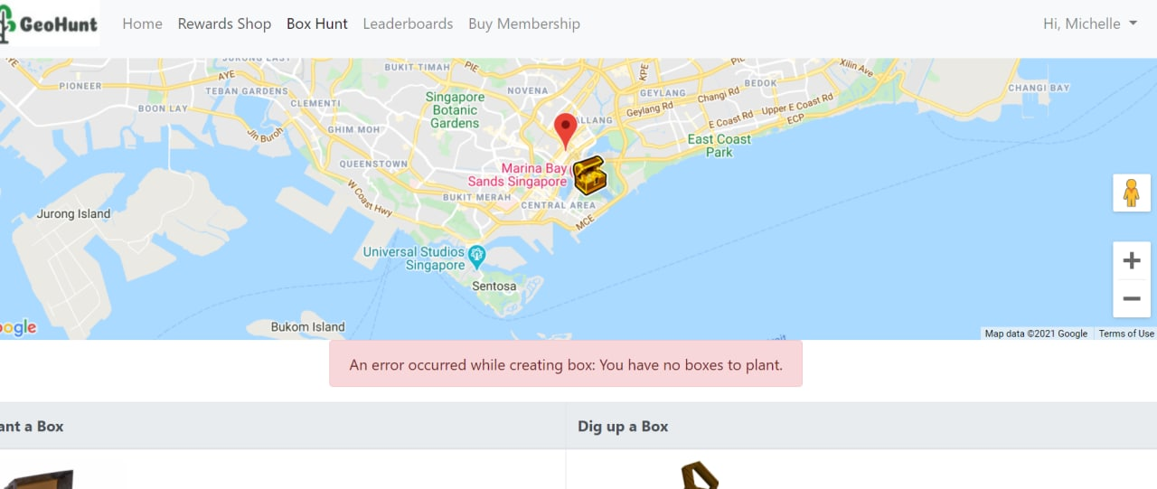
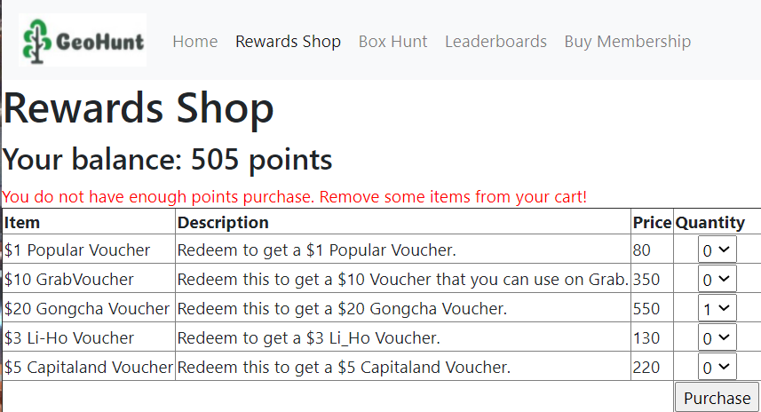

Slide 26
CONCLUSION
Notes:
Rmb bring back to objective of app

Slide 27
Q & A

